Slide 1
Analysis of
Track User Logs
Eric Malek
December 2017/January 2018

Slide 2
Part I: Trends over Time

Slide 3
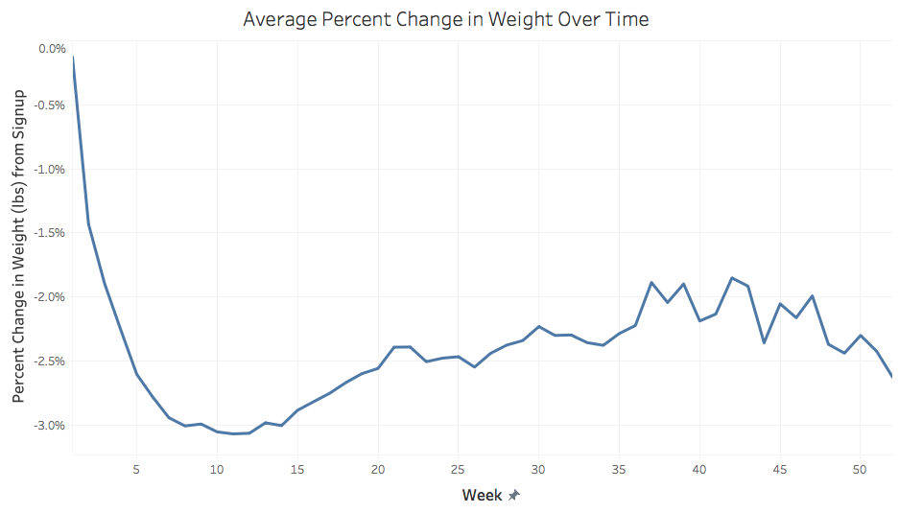
Users lose about 3% of their weight during the first 10 weeks after signup, but then gain about 1% of it back during the following 27 weeks. The correlation (r) between weight delta and time is -0.31, but r is much stronger (-0.51) for the first 10 weeks.

Slide 4
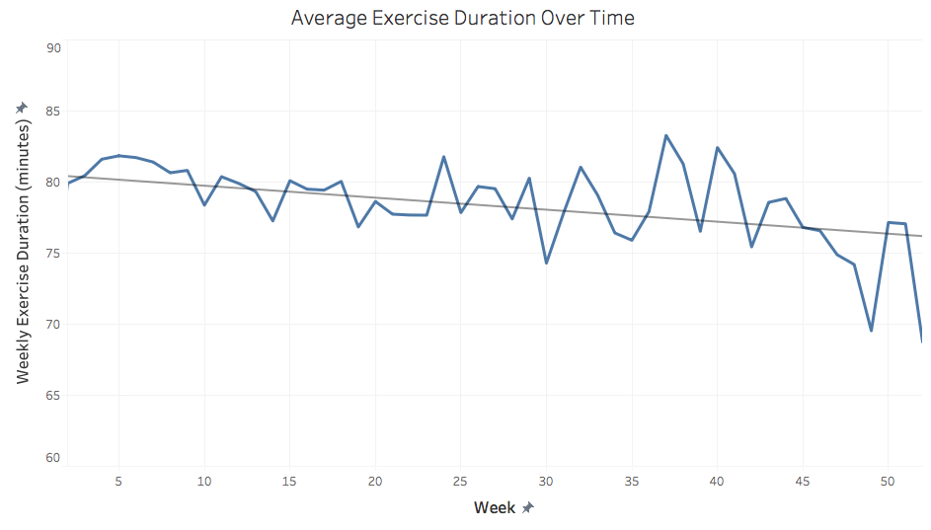
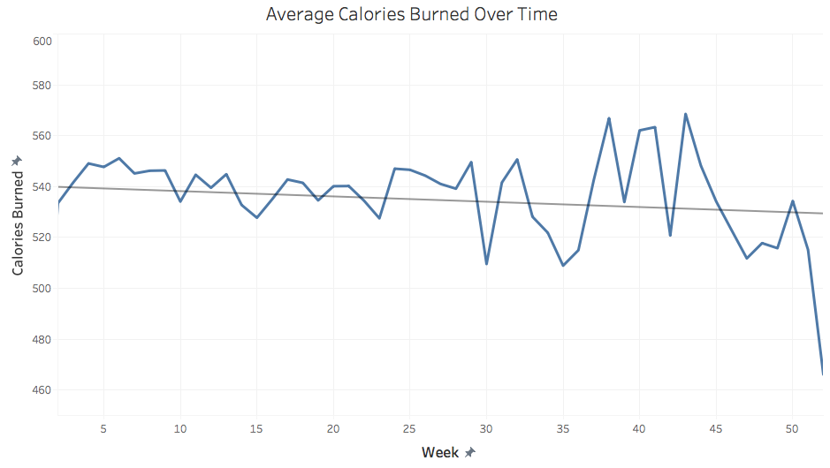
There is no notable change in weekly exercise duration or calories burned over time, after signing up for the app.
r = -.016 r = -.005

Slide 5
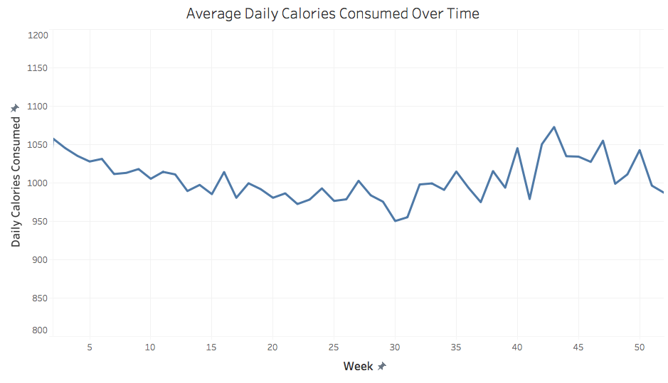
The average daily calories consumed decreases from about 1050 to 950 during the first 30 weeks after signing up, but then returns to its baseline level by week 43. The total number of daily calories is underestimated because most users do not record every meal.

Slide 6
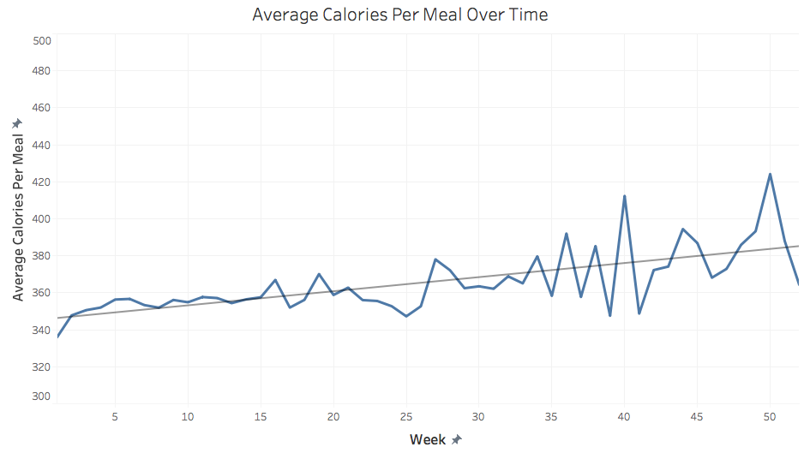
The average number of calories consumed per meal (defined as unique “consumed at” timestamps on the user food log) does not change very much over time, with only a slight increase noted, r = .031.

Slide 7
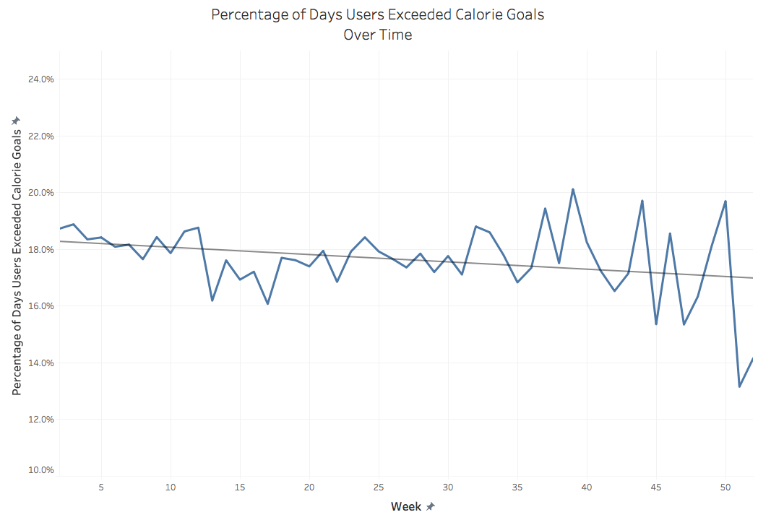
On average, users’ calorie consumption exceeds their stated calorie goals on 16-20% of days, or slightly more than 1 day per week. However, the actual number is probably higher, as users do not track all calories consumed in the app. The percent of days that users’ calorie consumption exceeds their goals does not change much over time, r = -.014.

Slide 8
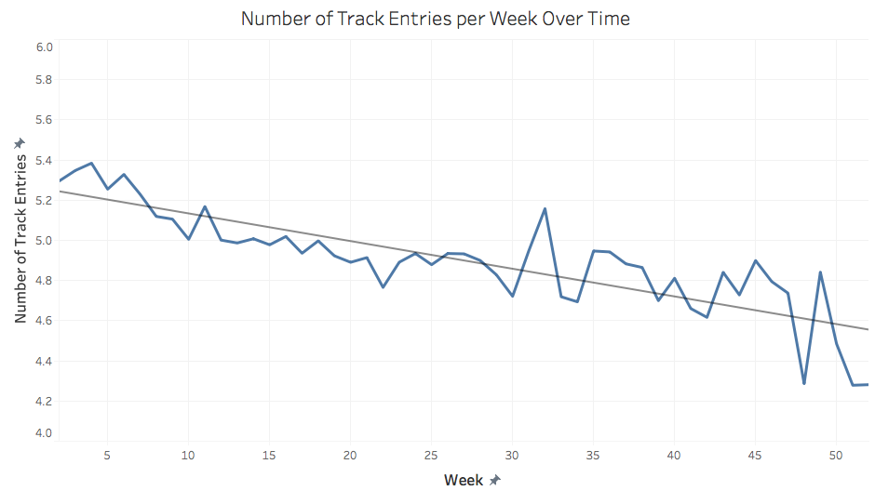
The average number of weekly Track entries (defined as unique “created at” timestamps on any user log) decreases steadily over time, from about 5 entries per week after signup to just over 4 entries per week one year after signing up, r = -.034.

Slide 9
Part II:
Comparing User Gender & Age

Slide 10
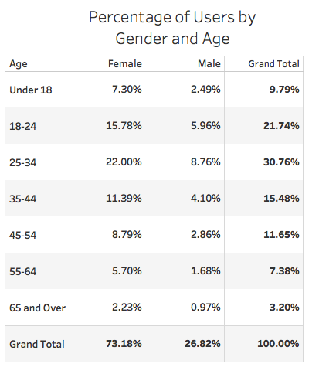
The vast majority of users (73.2%), both overall and within every age group, are female.
More than two-thirds of users (68%) are between 18 and 45 years of age, with the most common age group being 25-34.

Slide 11
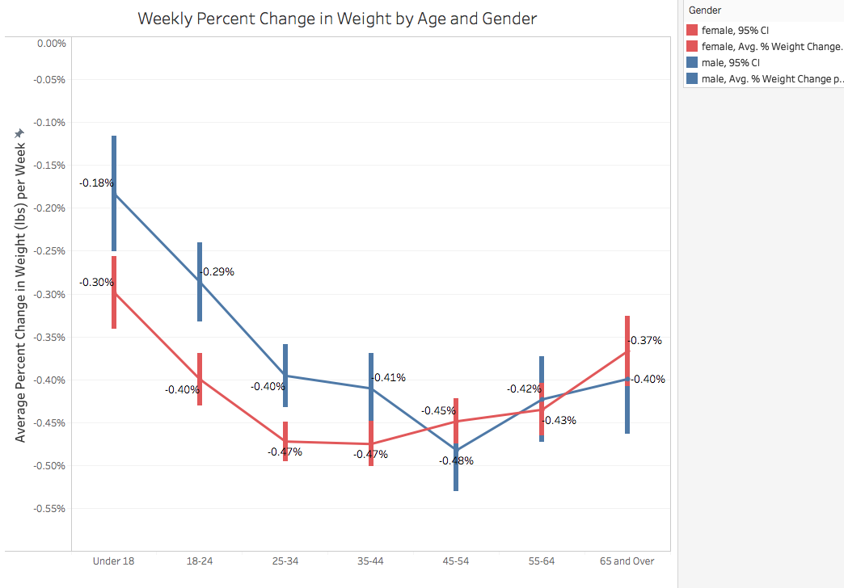
For both males and females, the middle 4 age groups (ages 25-64) experience the most week over week weight change. In addition, for users under 45, females experience greater weekly weight delta compared with males, p = .001.

Slide 12
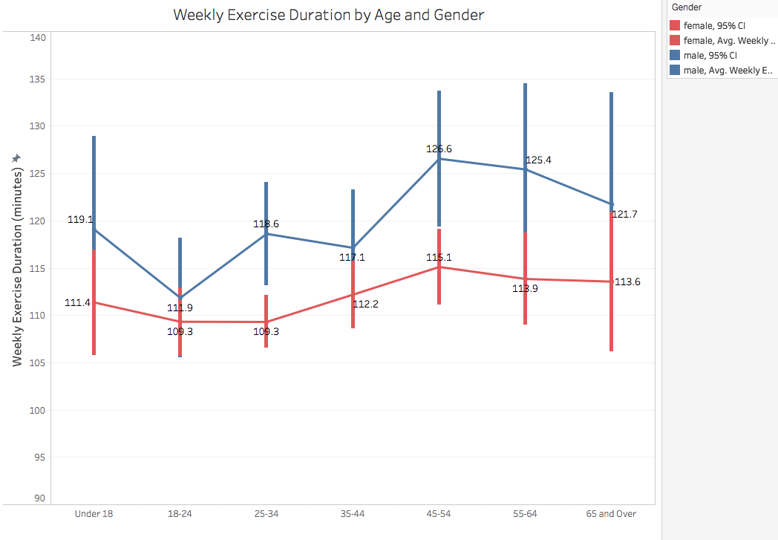
Across all age groups, male users exercise for more minutes per week than female users, p < .001. In addition, users aged 45 and above exercise for slightly more minutes compared with users under 45, p = .012.

Slide 13
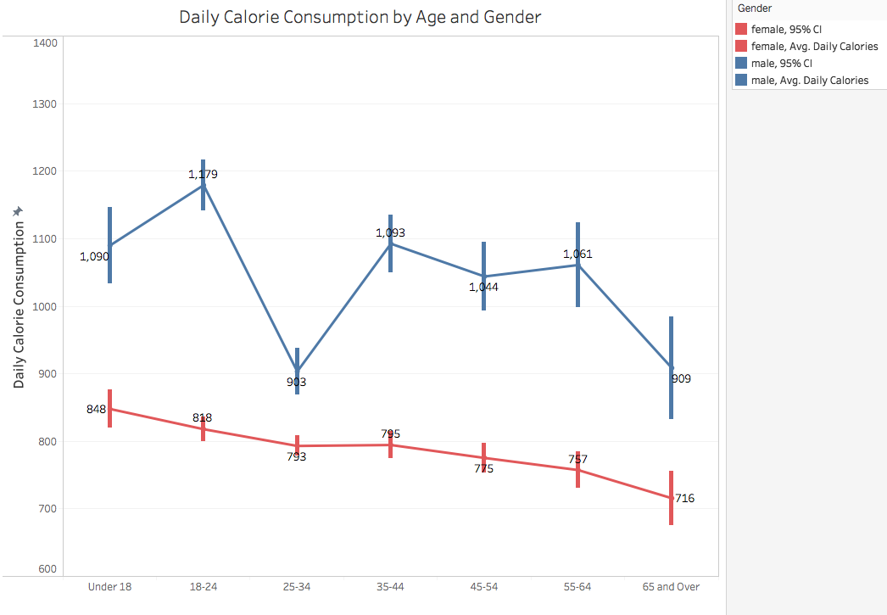
Male users consume significantly more calories daily compared with female users, p < .001. In addition, with the apparent exception of male users aged 25-34, users tend to consume fewer calories as they get older, p < .001. Again, the number of daily calories per group is likely underestimated, due to underreporting of meals.

Slide 14
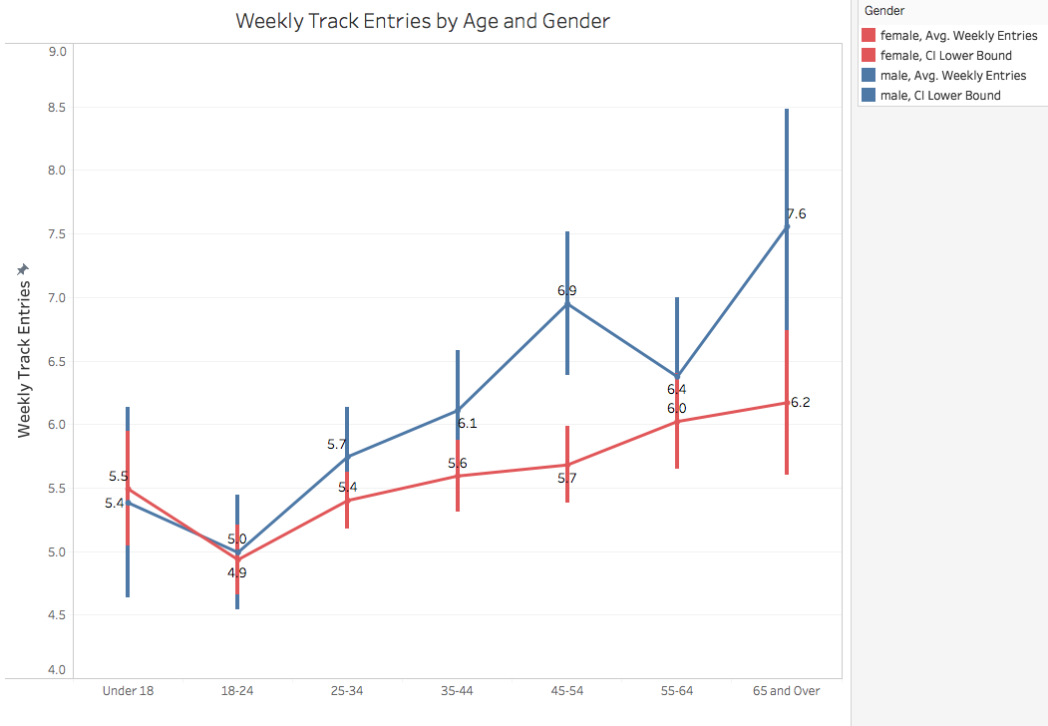
For users under 25, males and females have approximately the same number of weekly entries. For both genders, usage generally increases as age progresses, with older males (over 45) having considerably more weekly entries compared with older females, p = .021.

Slide 15
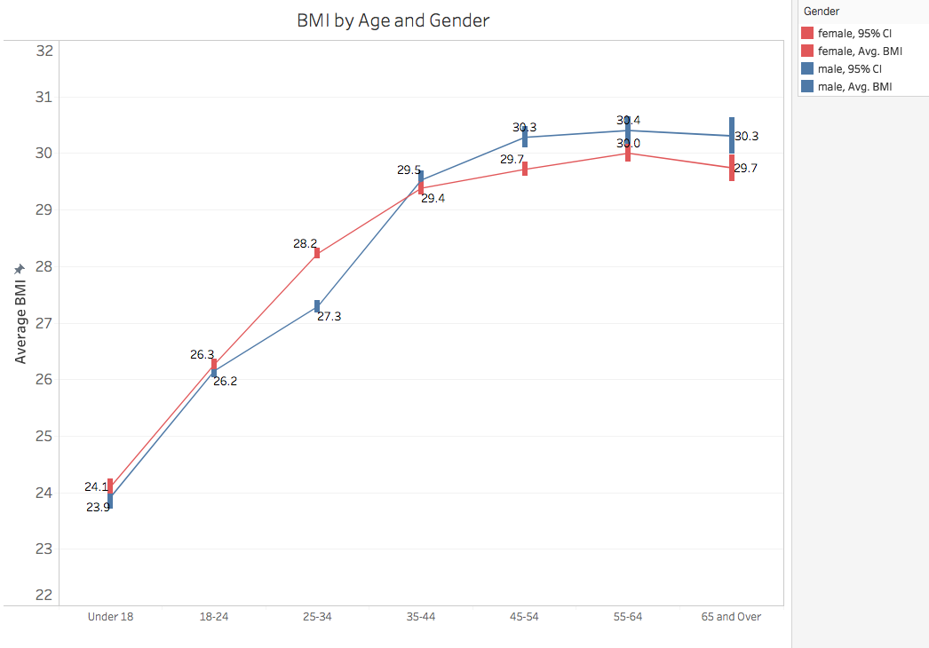
For both male and female users, BMI generally increases with age until around age 45, p < .001. For users under 35, females generally have slightly higher BMI than males, while for users over 35, males have higher BMI than females, p < .001.

Slide 16
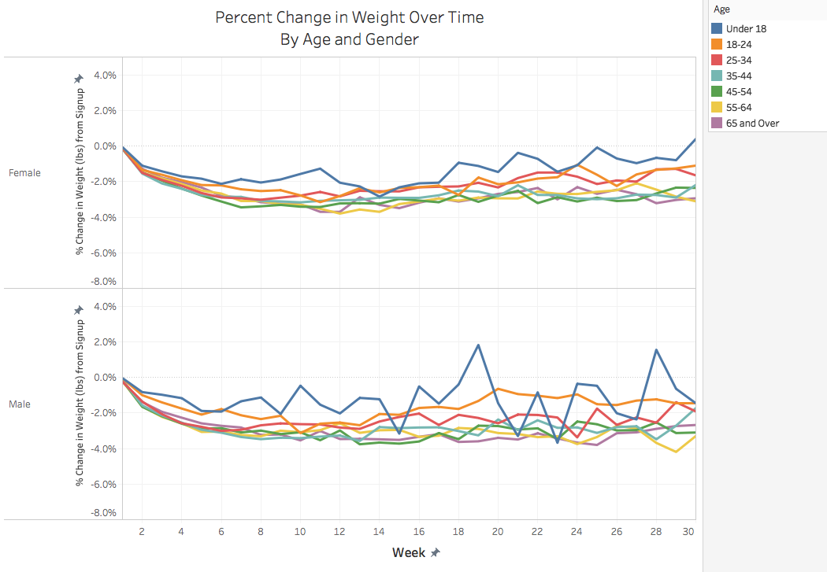
Across all age groups and genders, users see a steady drop in weight until about 8-10 weeks after signing up. For males, users under 18 years of age experience much more variability in weight change compared with other age groups.

Slide 17
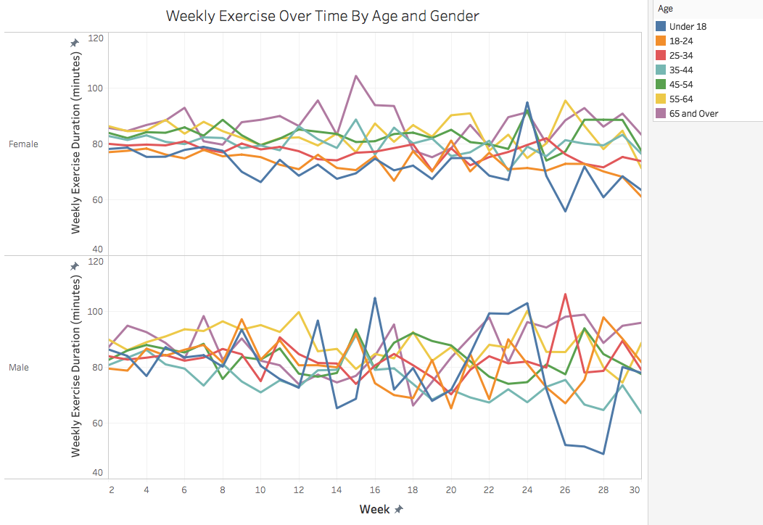
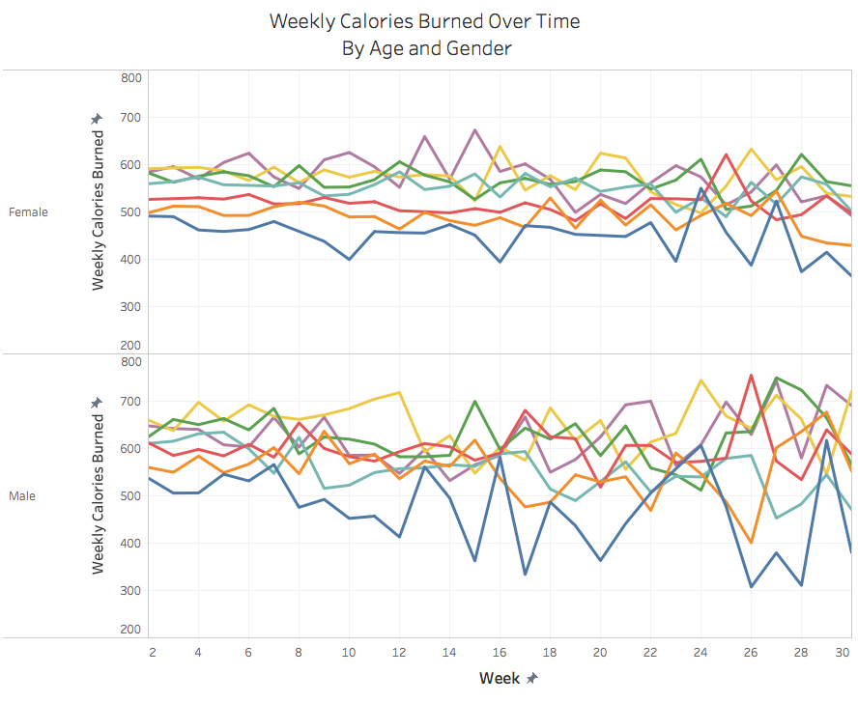
Overall, male users burn a greater number of calories per week compared with female users. There is no clear pattern in weekly exercise duration or number of calories burned across age groups.

Slide 18
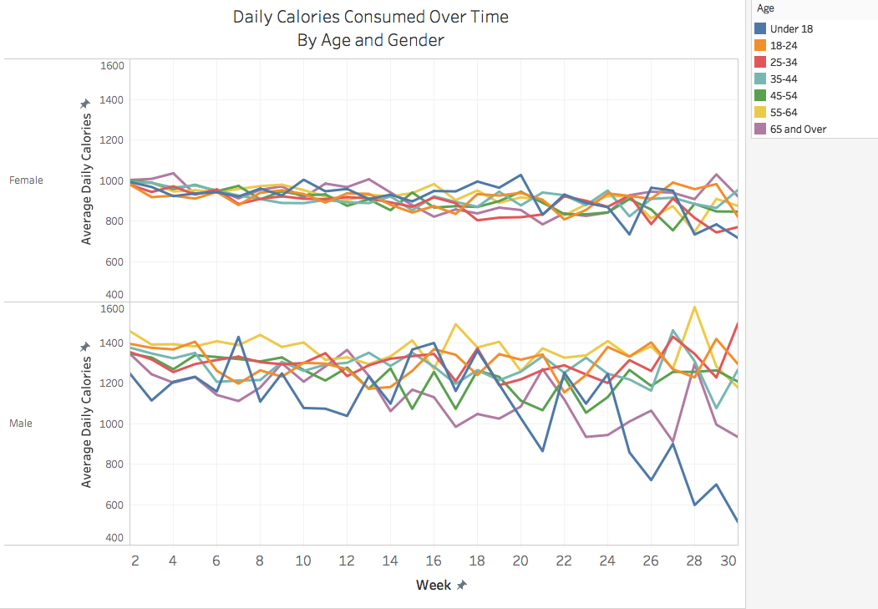
Overall, male users consume more calories per day than female users. They also experience higher variability in daily calorie consumption across age groups and time compared with female users. In addition, female users experience a small but consistent decline in daily calories consumed week over week, while this pattern is not as evident for male users.

Slide 19
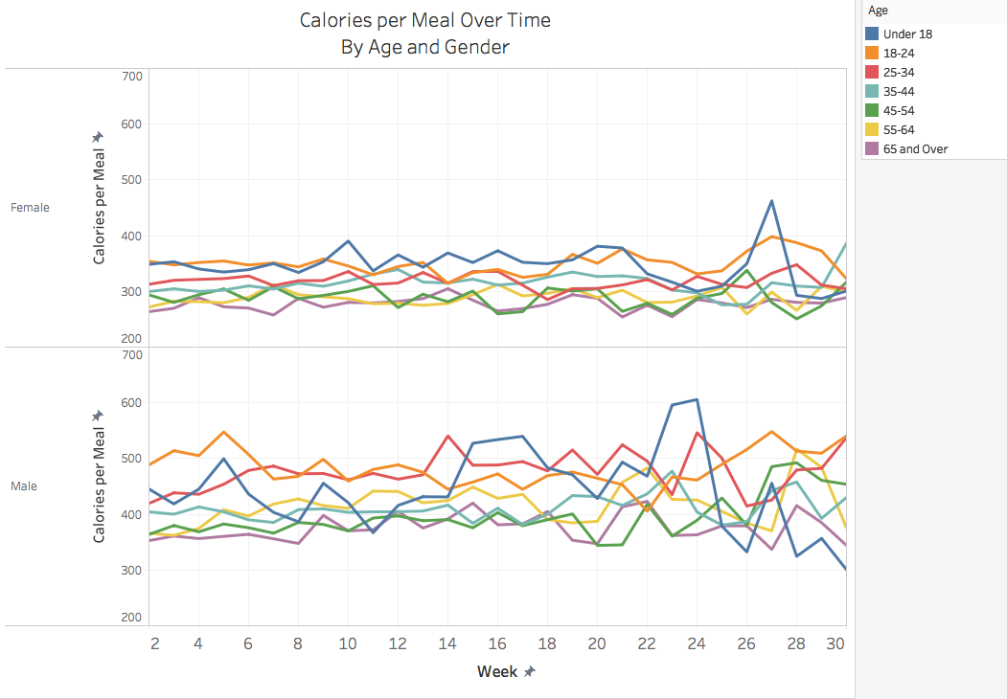
Overall, male users as well as younger users (under 35) consume more calories per meal compared with female users and users 35 years and older. This pattern remains generally consistent over time.

Slide 20
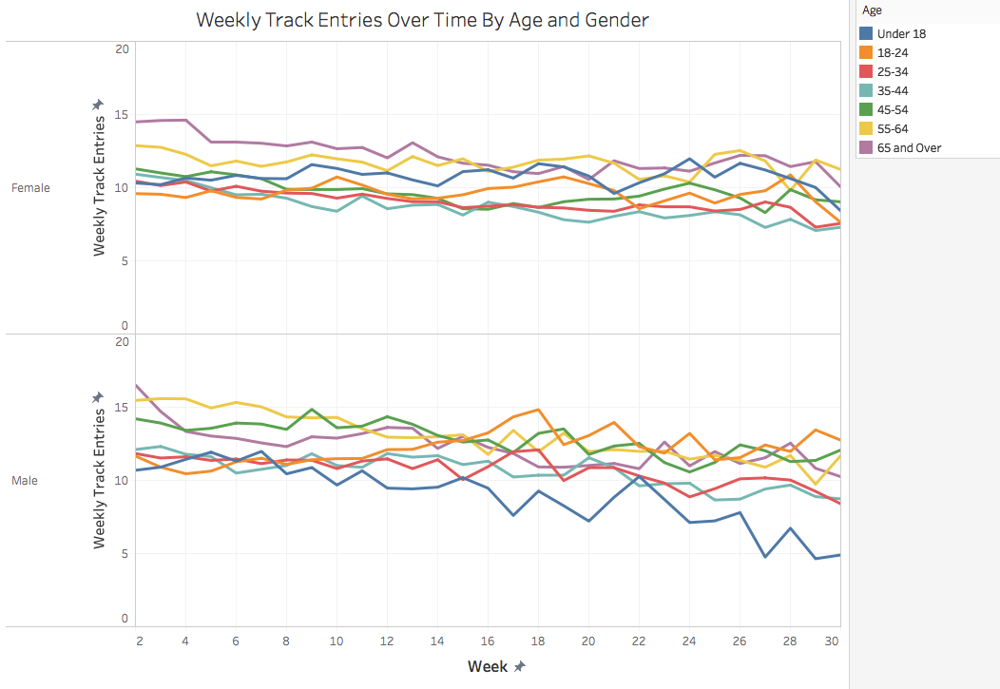
Weekly usage declines slightly over time for males and females of every age group. However, the sharpest drop-off in usage occurs for male users under 18 years of age. For this demographic, weekly usage decreases by half after 30 weeks (from about 10 entries per week to only 5).

Slide 21
Part III:
Exploring Relationships Among Weight, Exercise, Usage & Calorie Consumption

Slide 22
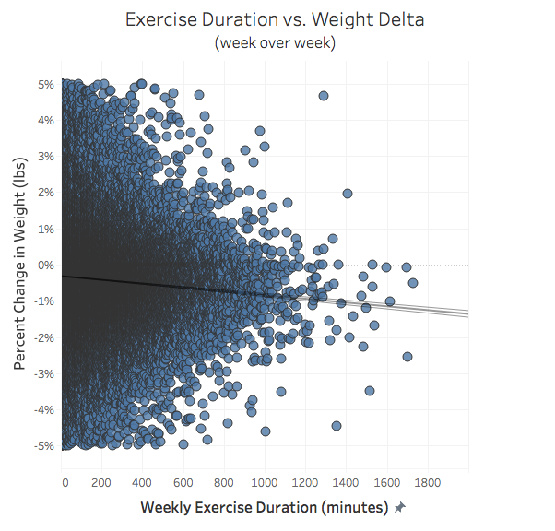
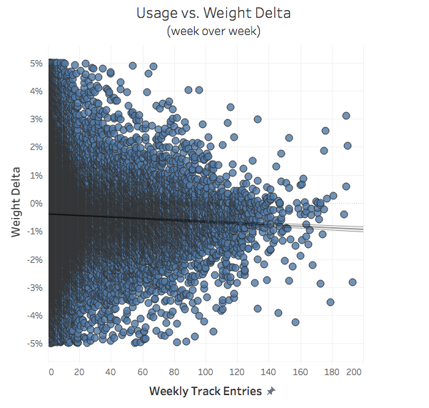
Surprisingly, there was only a small correlation between weekly exercise duration and weight change (expressed as a percent delta), r = -.027. The same pattern was observed for the relationship between weekly usage and weight change, r = -.019.

Slide 23
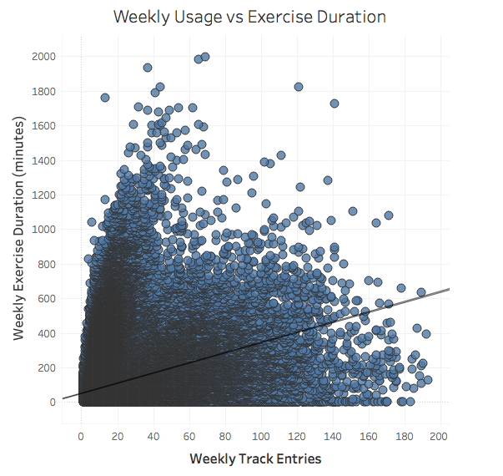
There is a moderate positive correlation between weekly usage and exercise duration, r = .353. However, this does not necessarily indicate that people who use the app more frequently are more motivated to exercise. Instead, it could simply mean that users who exercise more frequently have more entries to record, or that people who use the app more frequently are more diligent about recording their exercise sessions.

Slide 24
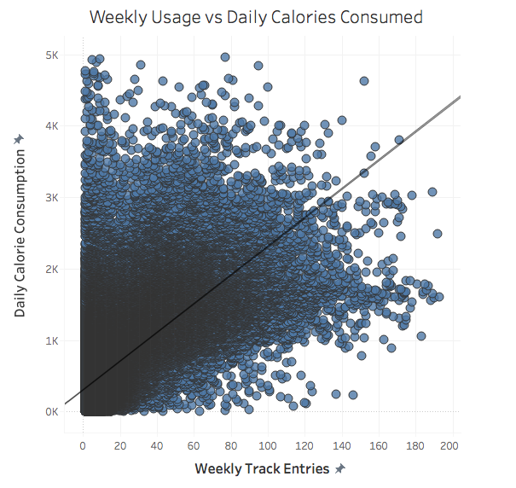
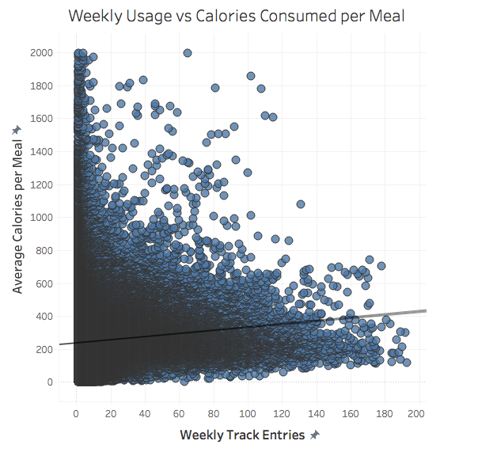
There is a fairly strong correlation between weekly usage and daily calorie consumption, r = .658. However, this does not necessarily mean that people who use the app more frequently consume more calories. It could simply indicate that more frequent users are more diligent about recording their meals. In fact, if we look at the relationship between usage and average calorie consumption per meal, the correlation is very modest, r = .095.

Slide 25
Part IV:
Calorie Composition

Slide 26
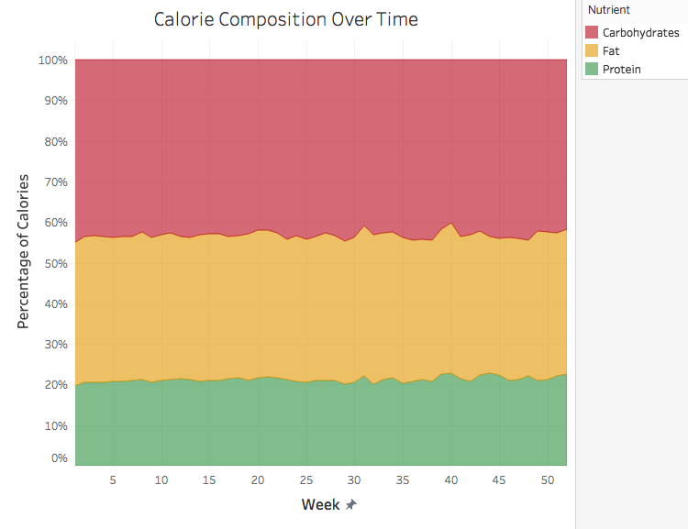
Overall, 21% of users’ calorie consumption consists of protein, 39% consists of fats, and 41% consists of carbohydrates. This composition remains fairly consistent over time.

Slide 27
Part V:
Weekdays vs. Weekends

Slide 28
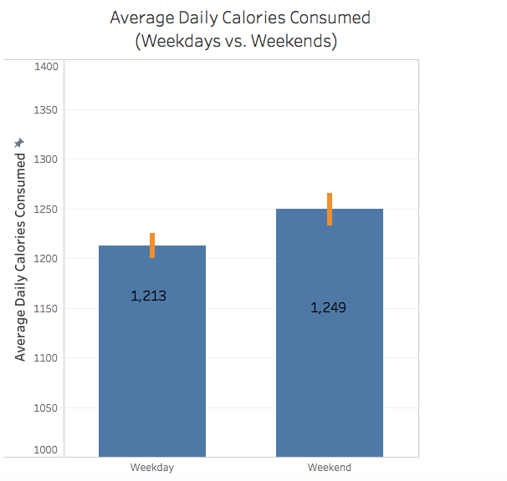
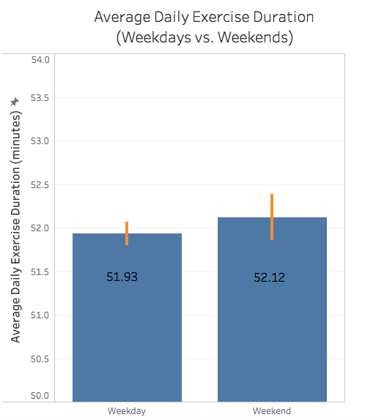
Overall, users consume about 3% more calories daily on weekends compared with weekdays, p < .001. However, there was no significant difference in average exercise duration between weekdays and weekends, p = 220.

Slide 29
Part VI:
Login Frequency

Slide 30
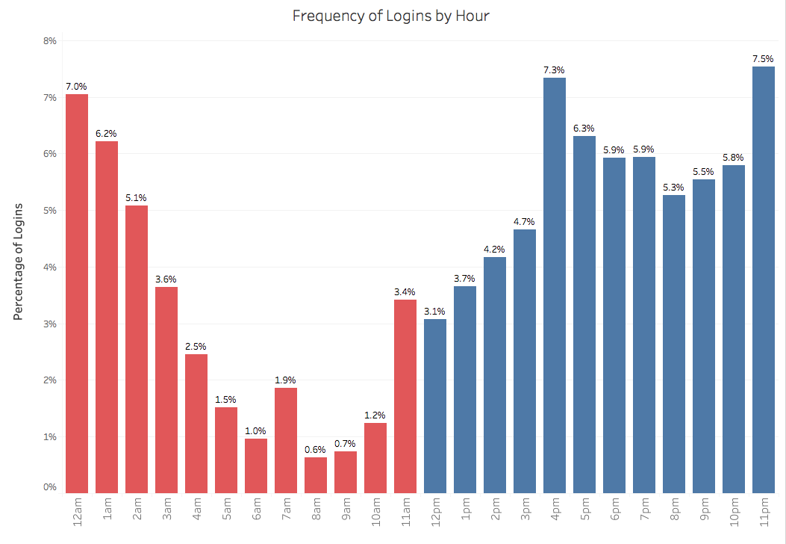
In general, users appear to be logging in throughout the day, although nearly ⅔ of logins (62.7%) occur in the evening, between 4pm and 1am. The least popular times are between 4am and 10am, with only 9.4% of all logins occurring during this period.

Slide 31
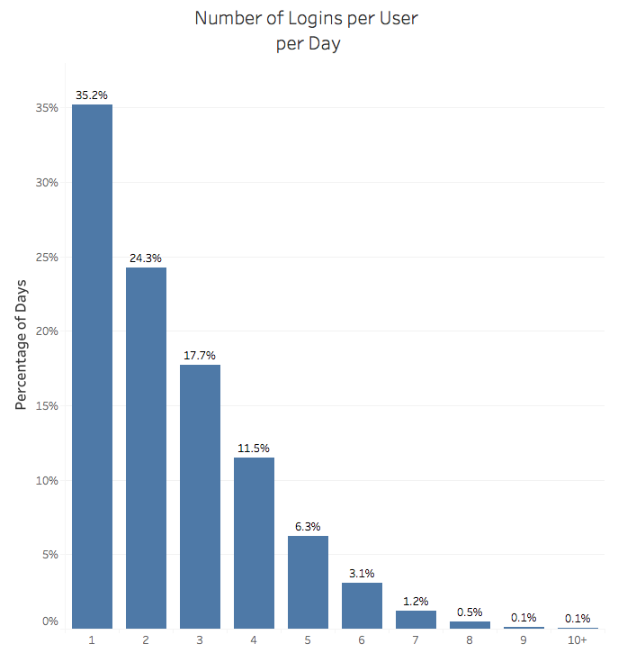
Nearly ⅔ of users (64.8%) login more than once per day, with more than 40% of users (40.5%) logging in 3 or more times per day.
The median number of logins per day is 2.

Slide 32
Part VII:
Breakdown of Food Consumption

Slide 33
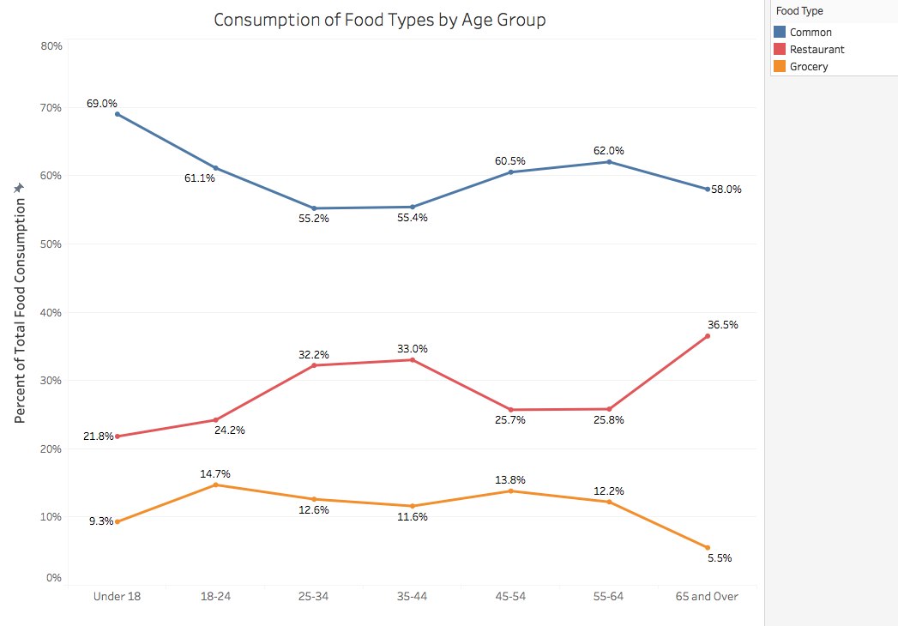
Overall, Common foods are the most common type of food (no pun intended), with more than 50% of foods falling into this category across age groups. Users aged 65+ tend to eat out at restaurants more than any other age group (36.5%), while younger users (under 25) eat out at restaurants the least (23.0%), p < .001.

Slide 34
Part VIII:
Breakdown of Consumption by Meal Type

Slide 35
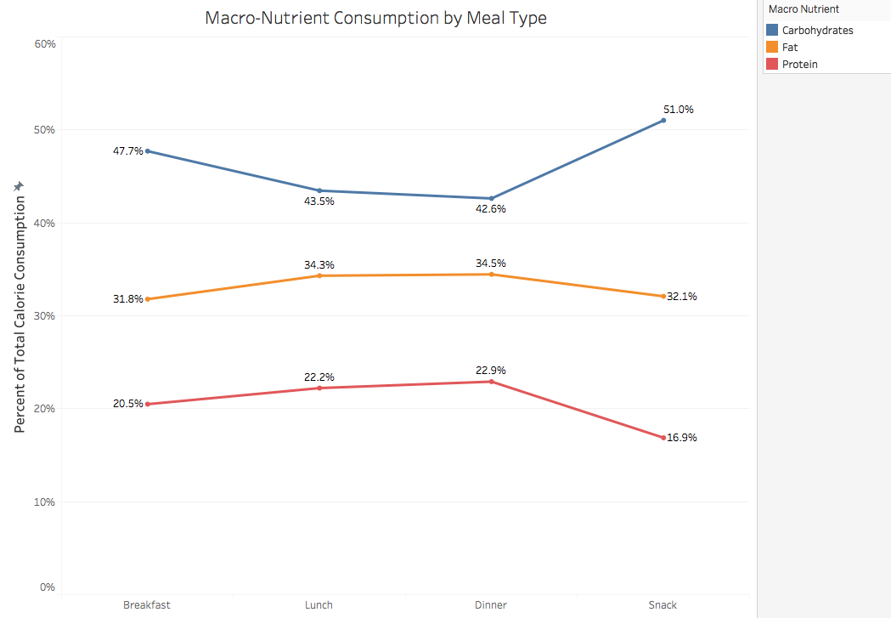
Not surprisingly, snacks appear to be the unhealthiest meal, with the highest percentage of carbs (51%) and the lowest percentage of protein (16.9%), p < .001. This is followed by breakfast, with 47.7% of calories as carbs and only 20.5% of calories as protein. The proportion of fat appears to be quite consistent across meal types.

Slide 36
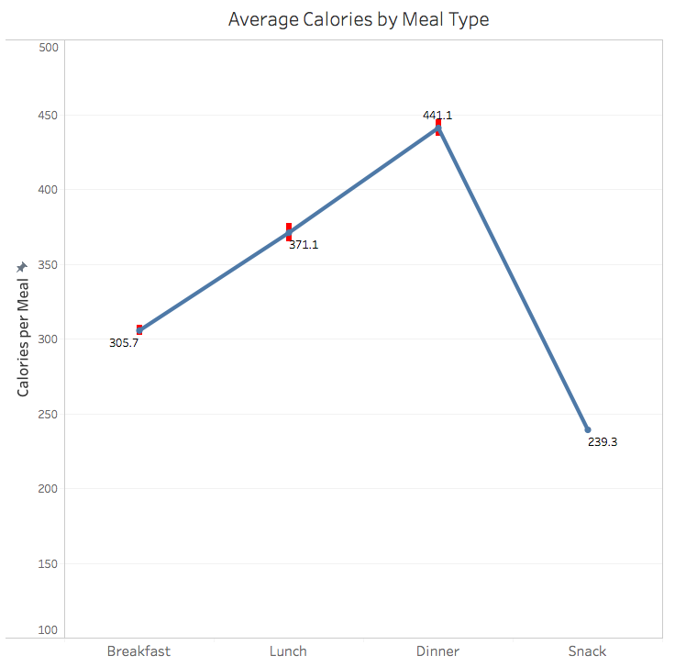
Not surprisingly, of the 3 primary meals, breakfast had the fewest average number of calories (22.5%) while dinner had the most (32.5%), p < .001. The average calories for snacks were lower than for any of the meals (17.6%), p < .001. Please note that the total number of calories per meal is likely underestimated, since not all users report every item they consume.

Slide 37
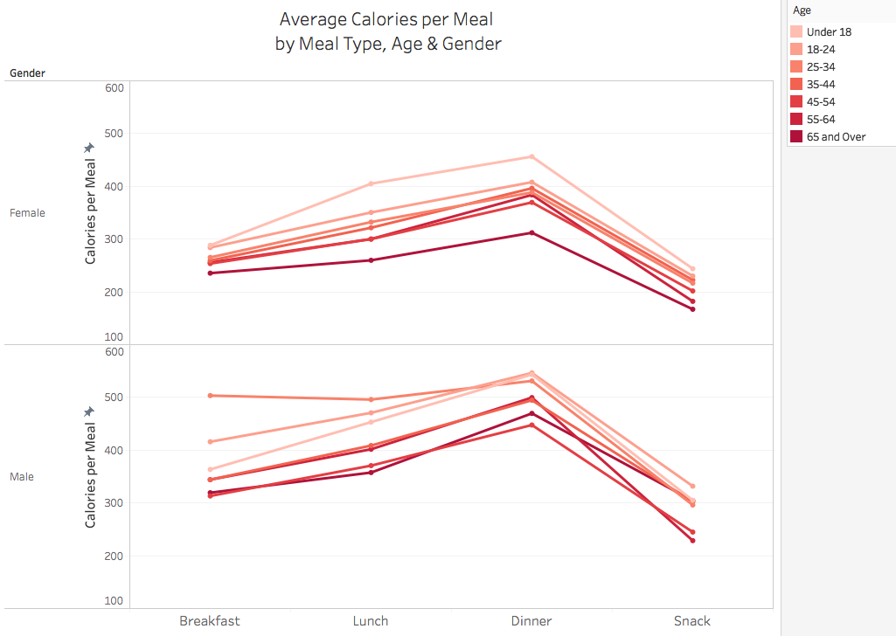
In general, male users consume more calories than female users across meals, and younger users consume more calories than older users, p < .001. In addition, while overall, users consume more calories at lunch compared to breakfast, this difference is more pronounced for female users compared to male users, F = 192.5, p < .001.

